Slide 1
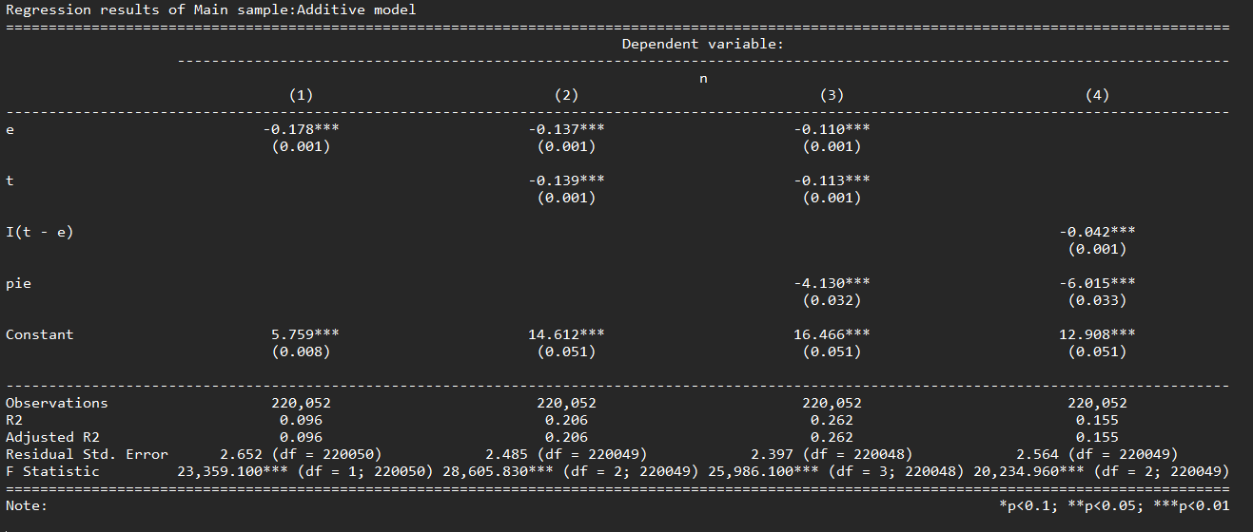
Standard Model with standalone variables

Slide 2
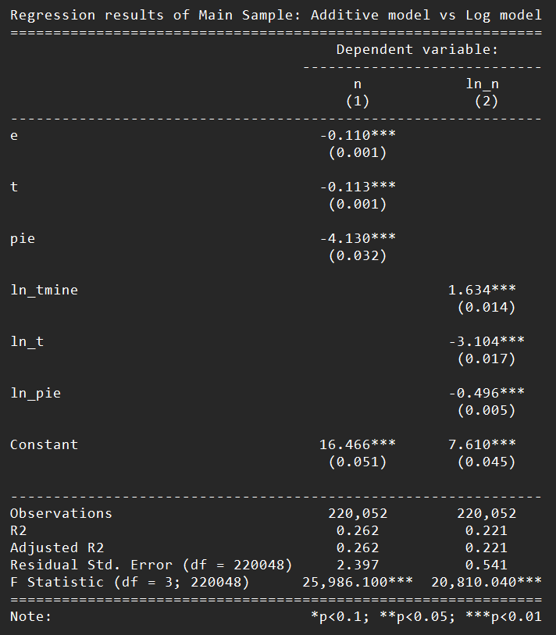
log model has slightly lesser fit compared to standard model
Multicollinearity slightly high for log model
> vif(reg_main_model0)
e t pie
1.08501 1.12303 1.13689
vif(reg_main_model1)
ln_tmine ln_t ln_pie
2.672833 2.865625 1.122241

Slide 3
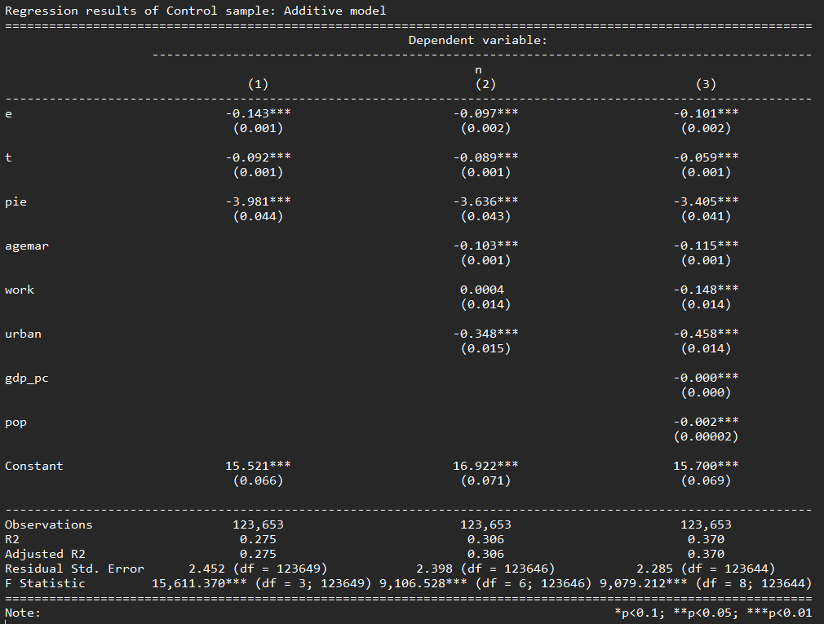
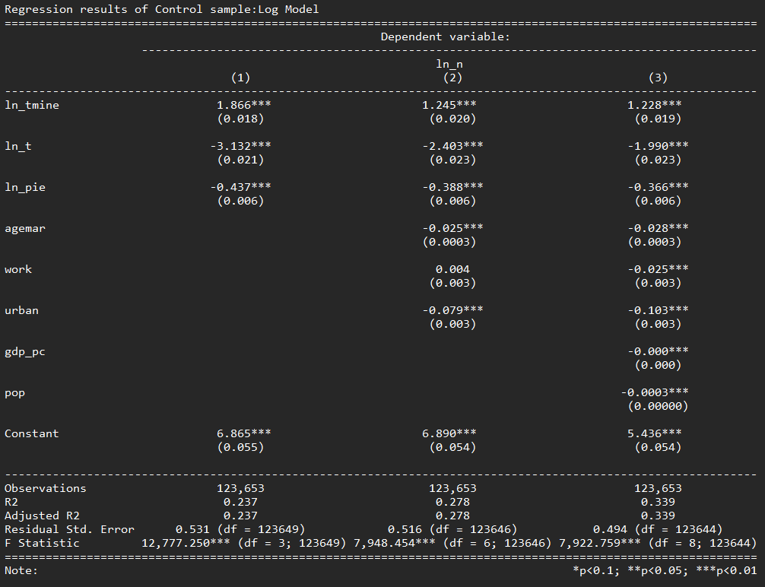
As more controls added, fit improves, education coeff also decreases

Slide 4
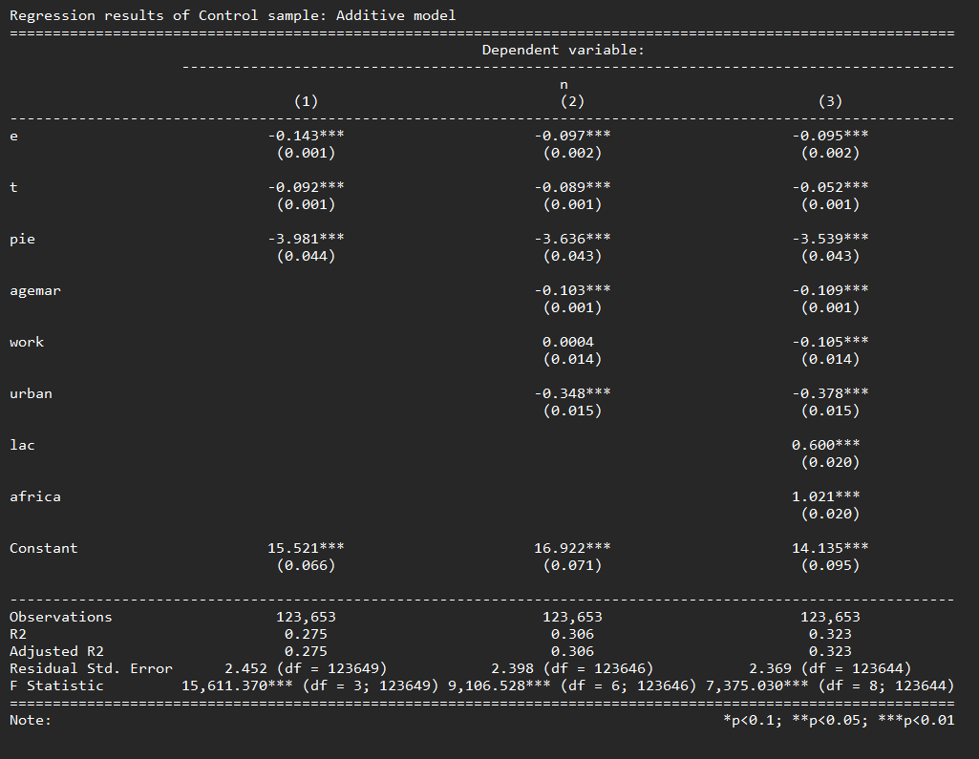
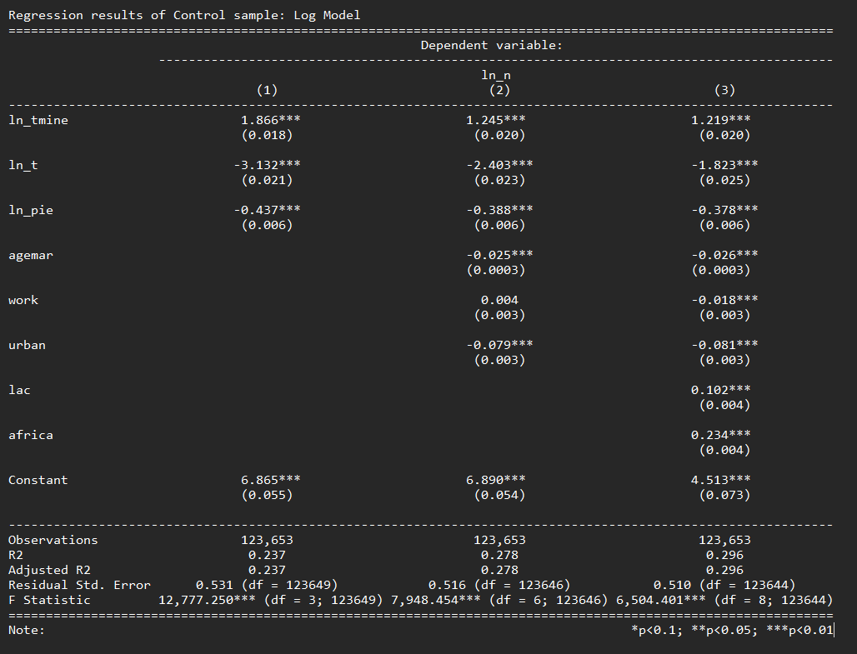
Fertility is higher in Africa and Latin America compared to Asia

Slide 5
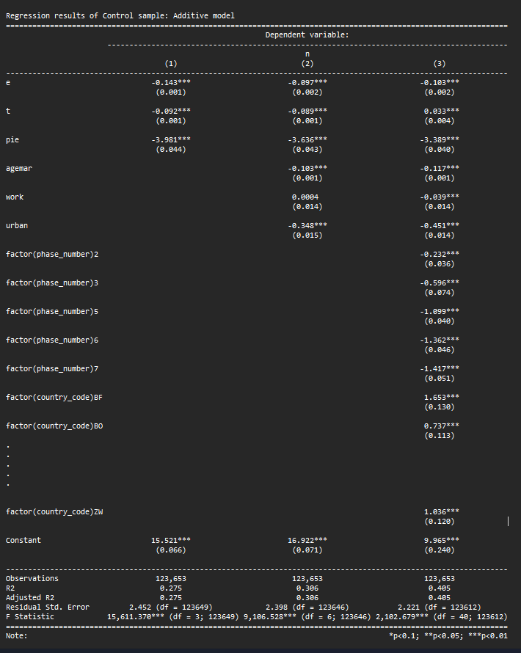
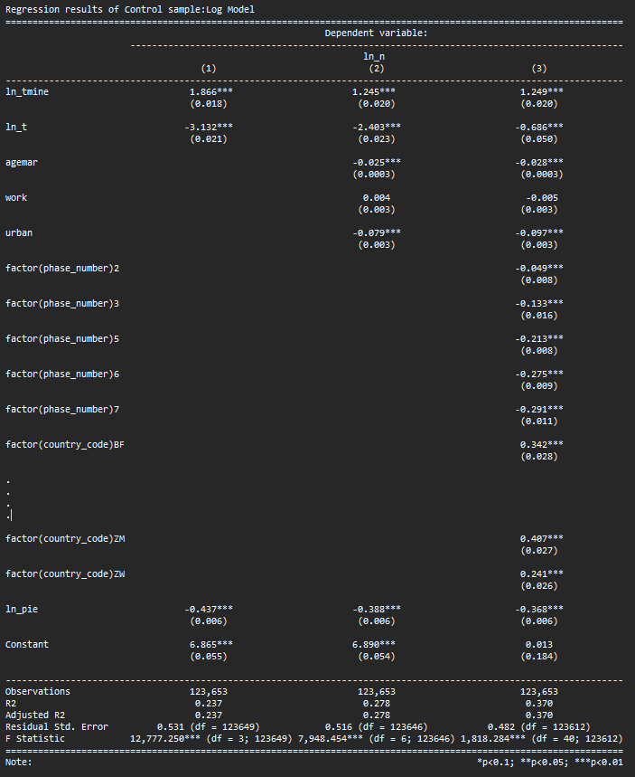
With country and time fixed effects, fit improves further
In recent times, fertility lower

Slide 6
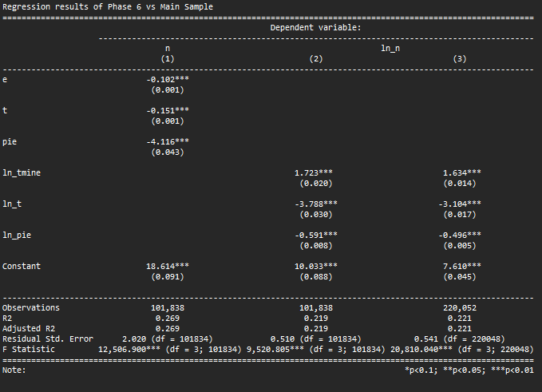
Cross country data : Phase 6

Slide 7
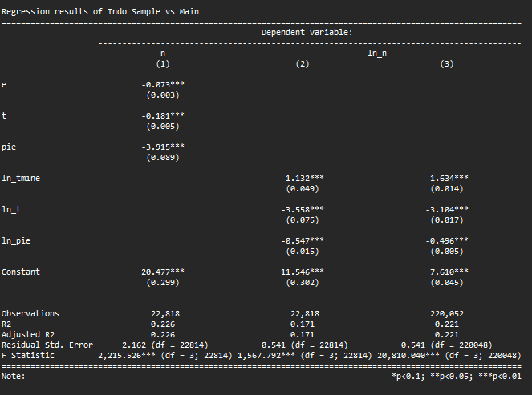
Multiple phases pooled overtime for one country: Indonesia overtime

Slide 8
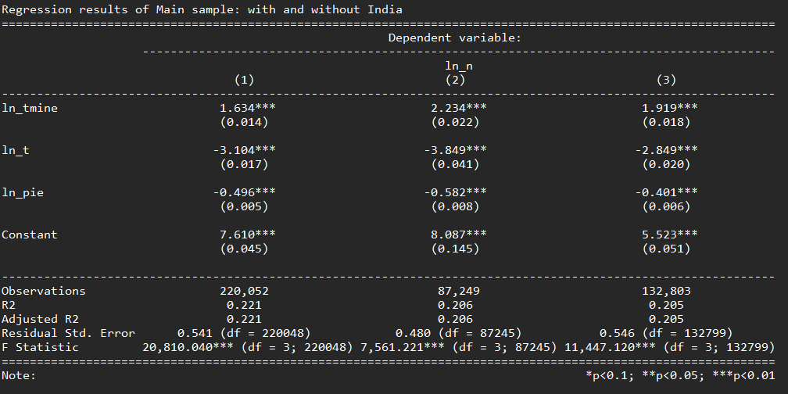
With India(2) and without india (3);
(2) is only India and (3) is the rest without india

Slide 9
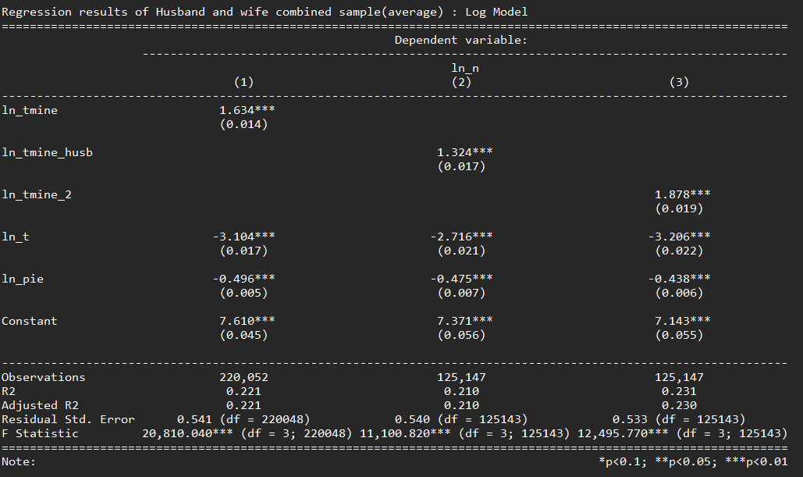
Husband education + wife education
Similar coeffs across.
Combined is more similar with women’s education only.

Slide 10
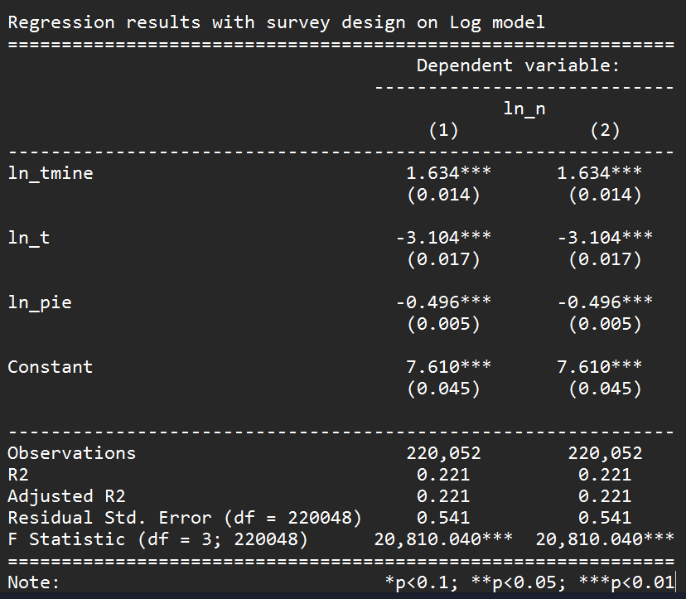
Survey Design elements added – no change in variables or std errors

Slide 11
Remove Indonesia and test out of sample fit

Slide 12


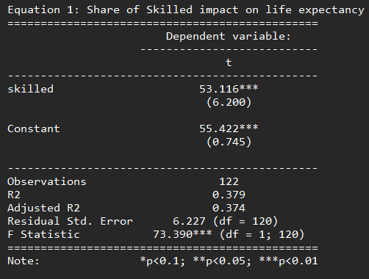
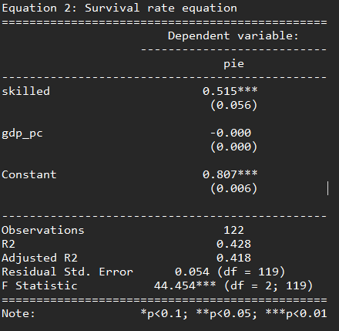
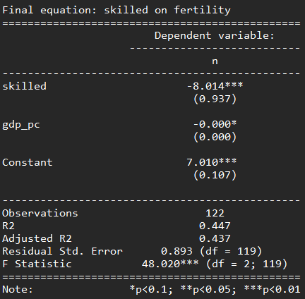

2 stage least square – Secondary equations
$$n_{t}^{∗}=γ \frac{\left(\underline{T}+ρλ_{t−1}−e^{j}\right)}{\left(\underline{T}+ρλ_{t−1}+γ\right)r_{t}^{j} ∗ \left(1− \frac{1−\underline{π}}{1+κλ_{t−1}y_{t−1}}\right)}$$

Slide 13
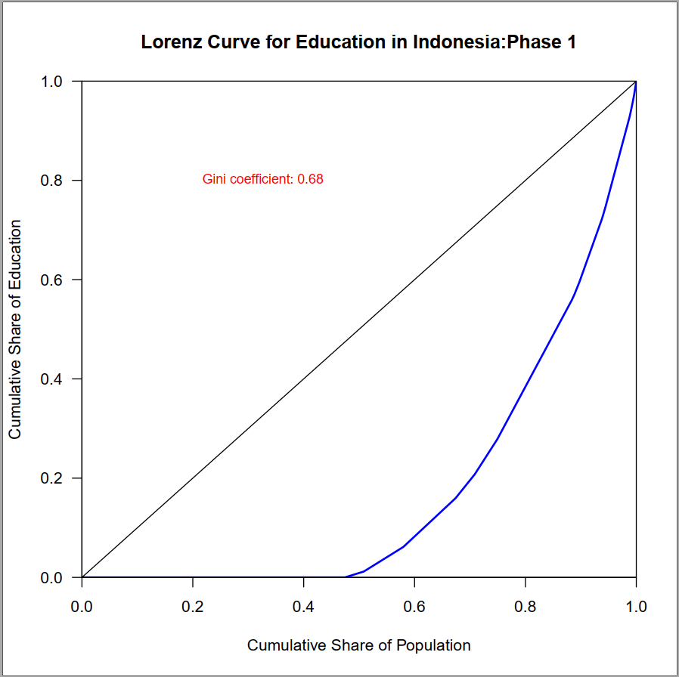
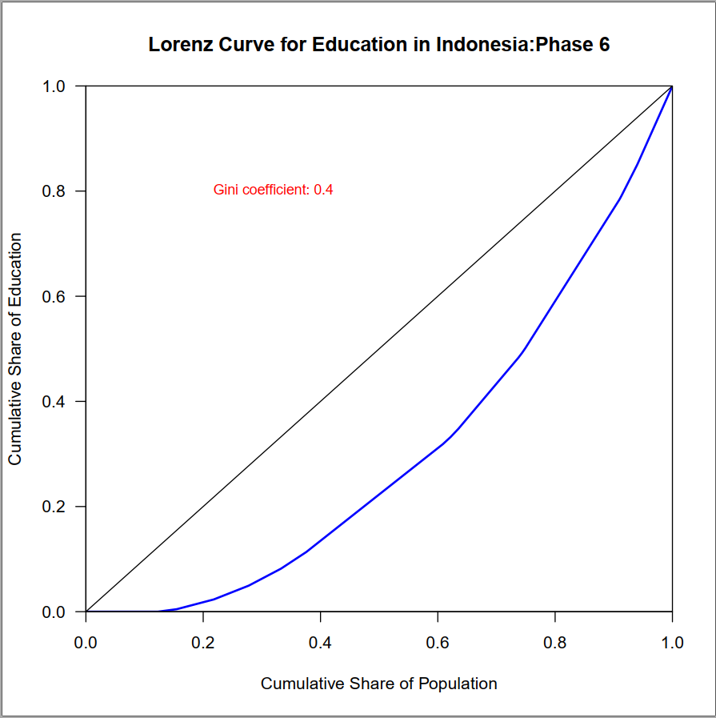
Inequality in Education : Lorenz curve for Indonesia

Slide 14
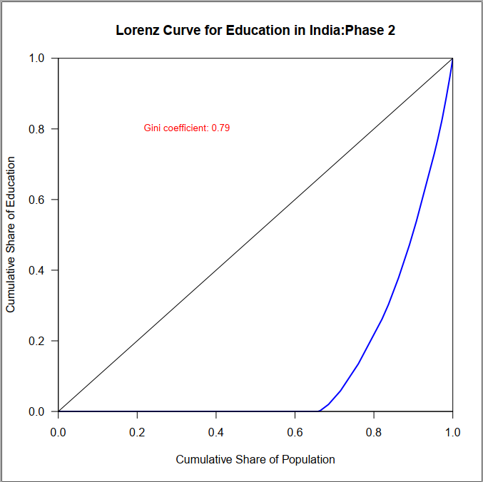
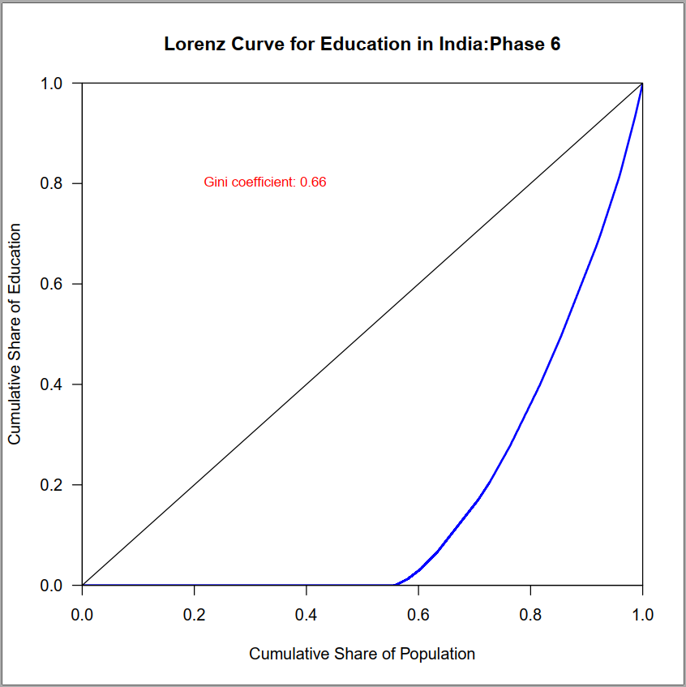
Inequality in Education : Lorenz curve for India

Slide 15
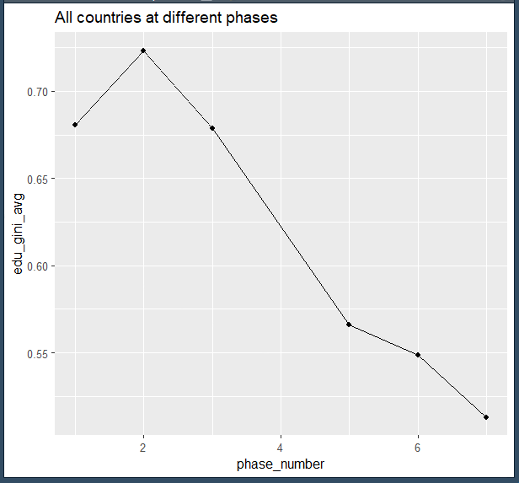
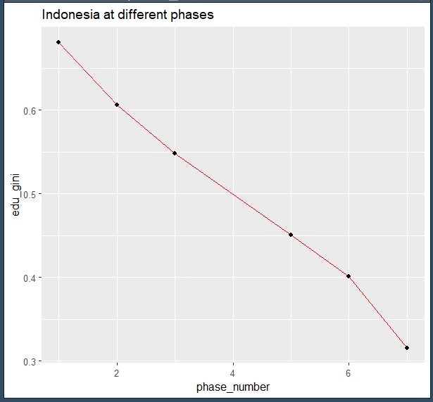
Inequality in Education reducing overtime for most countries

Slide 16
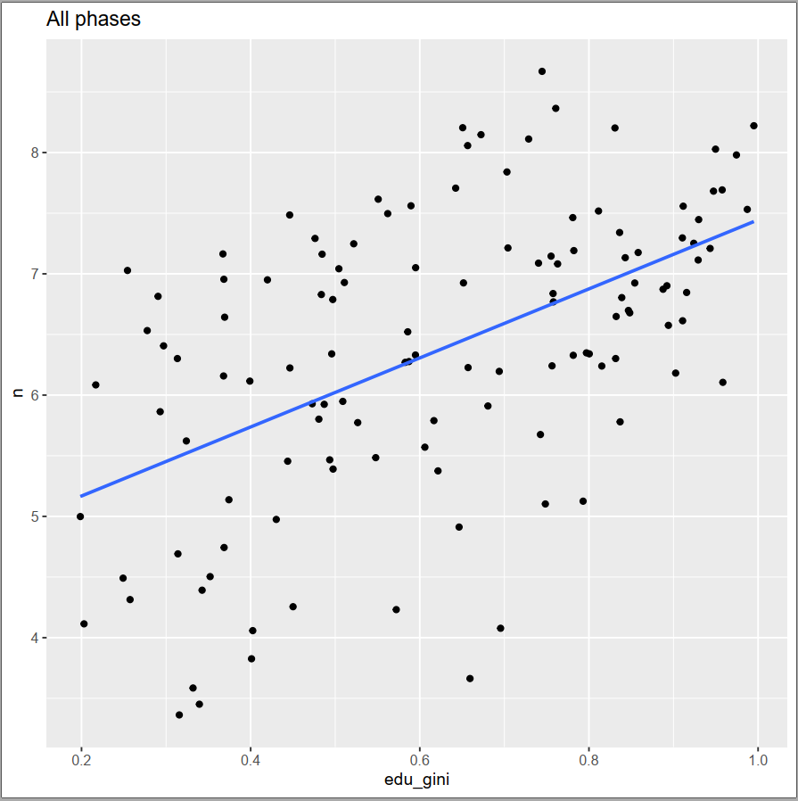
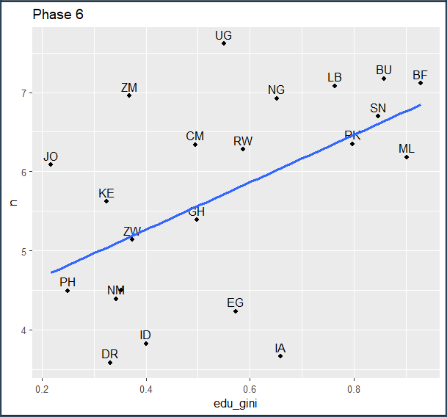
Inequality in Education and Fertility effects

Slide 17
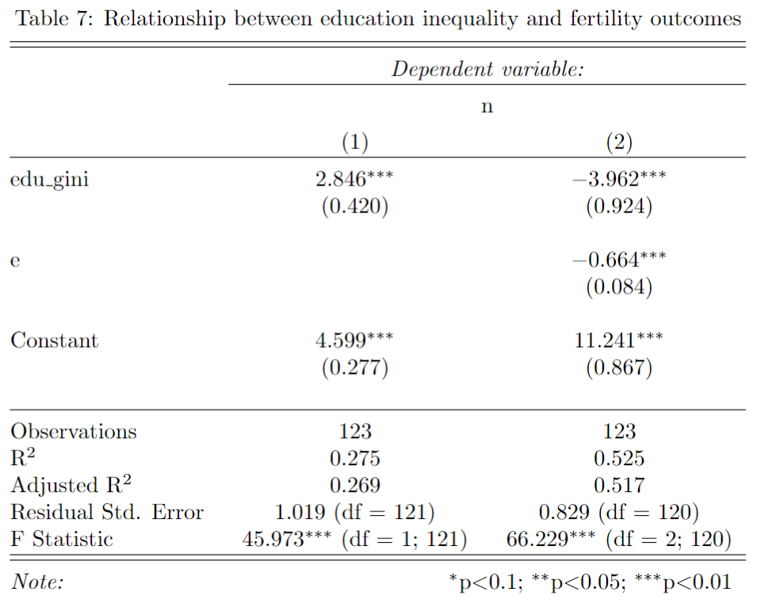
Relationship between education gini and fertility not as expected
vif(reg_2)
edu_gini e
7.31864 7.31864

Slide 18
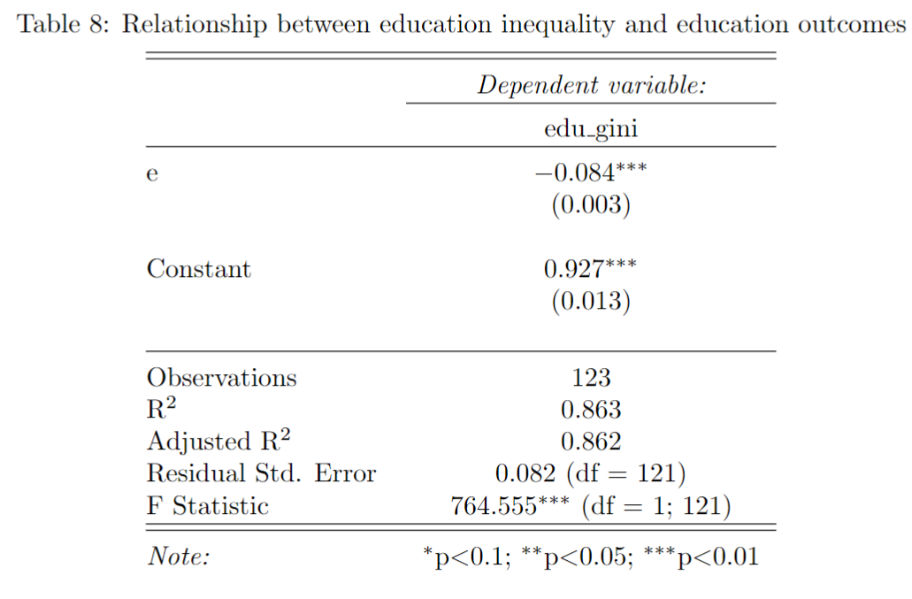
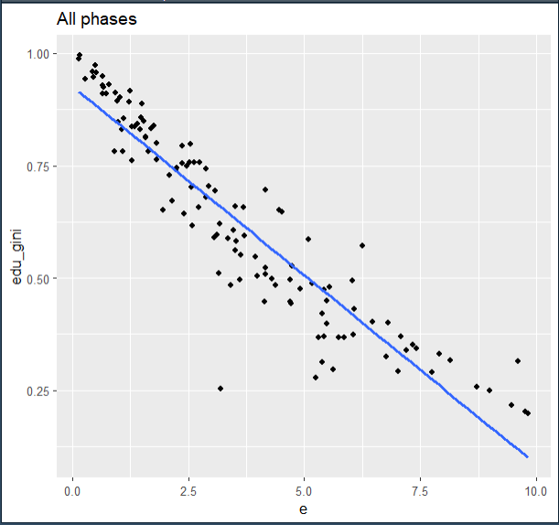
Inequality in Education and education

Slide 19
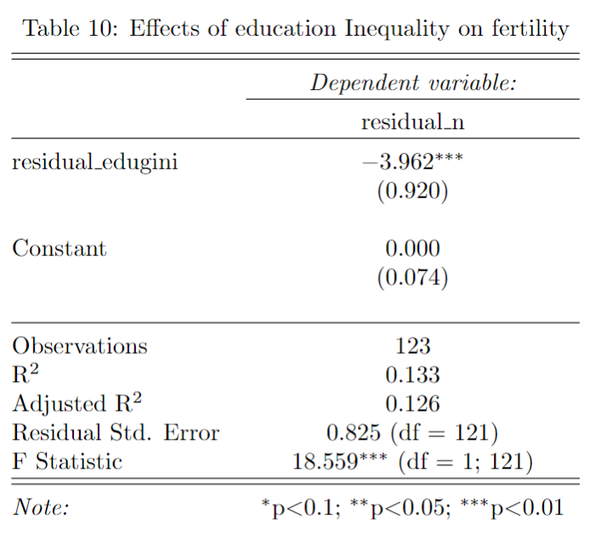
Inequality in Education and fertility after removing education effects

Slide 20
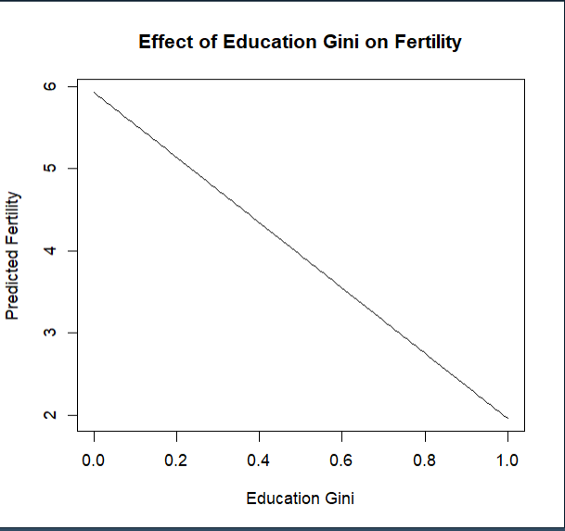

Slide 21
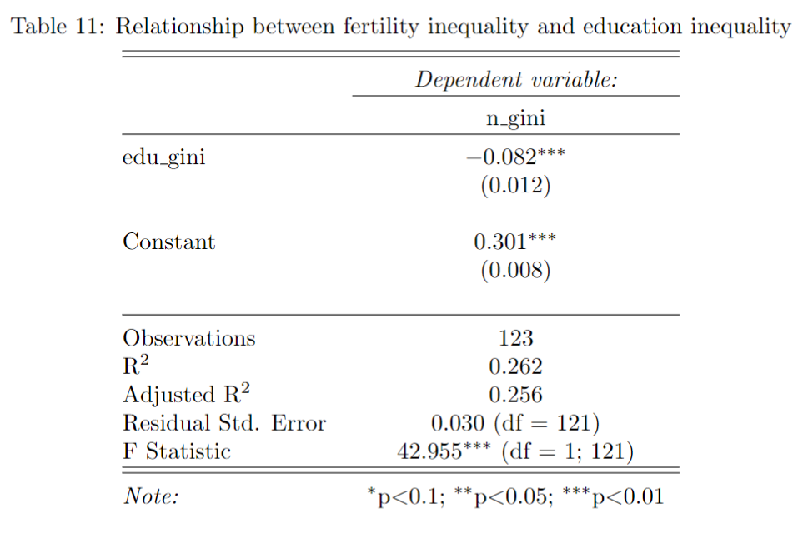
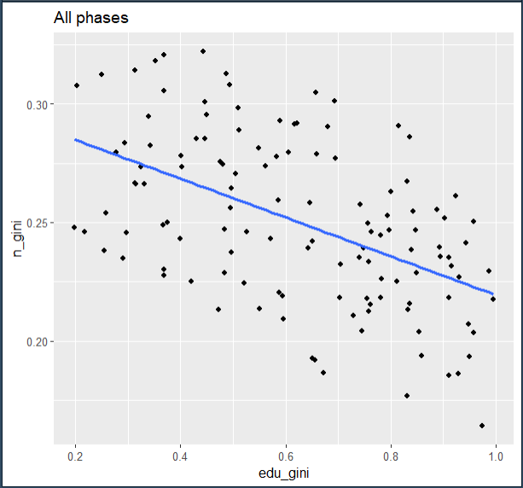

Slide 22
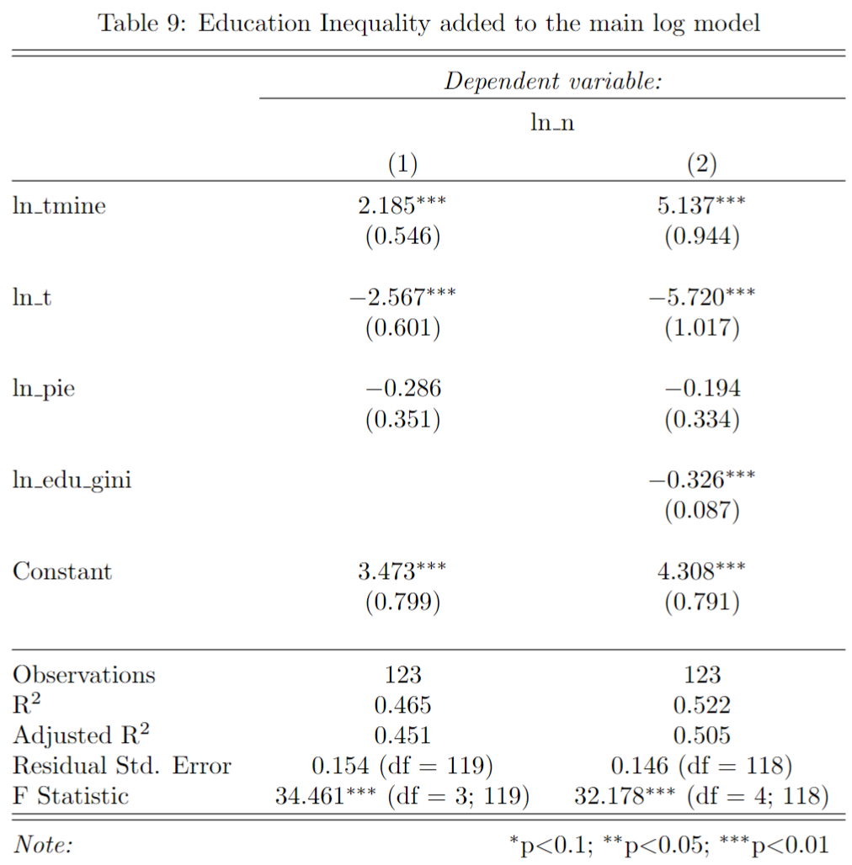
> vif(reg_main_model1) ln_tmine ln_t ln_pie 22.092948 34.627241 4.843874
vif(reg_main_model2) ln_tmine ln_t ln_pie ln_edu_gini 73.212787 109.973440 4.870532 7.100209

Slide 23
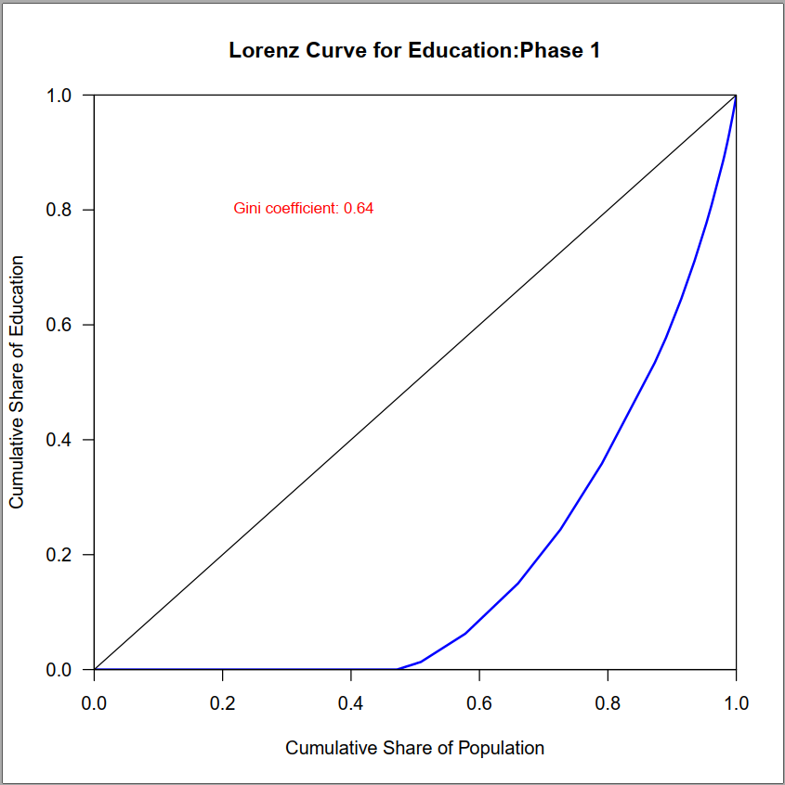
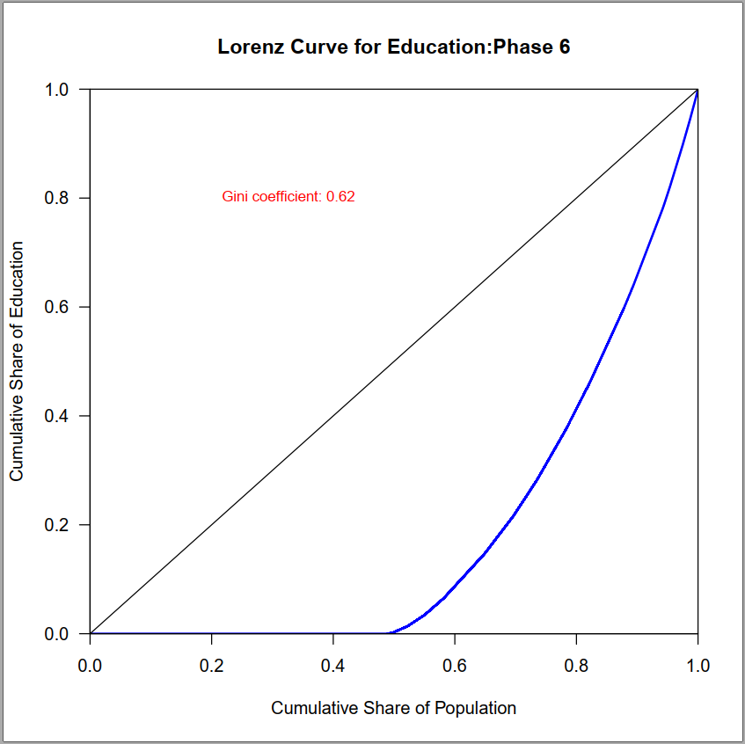
Inequality in Education : Lorenz curve for all countries at two different phases

Slide 24
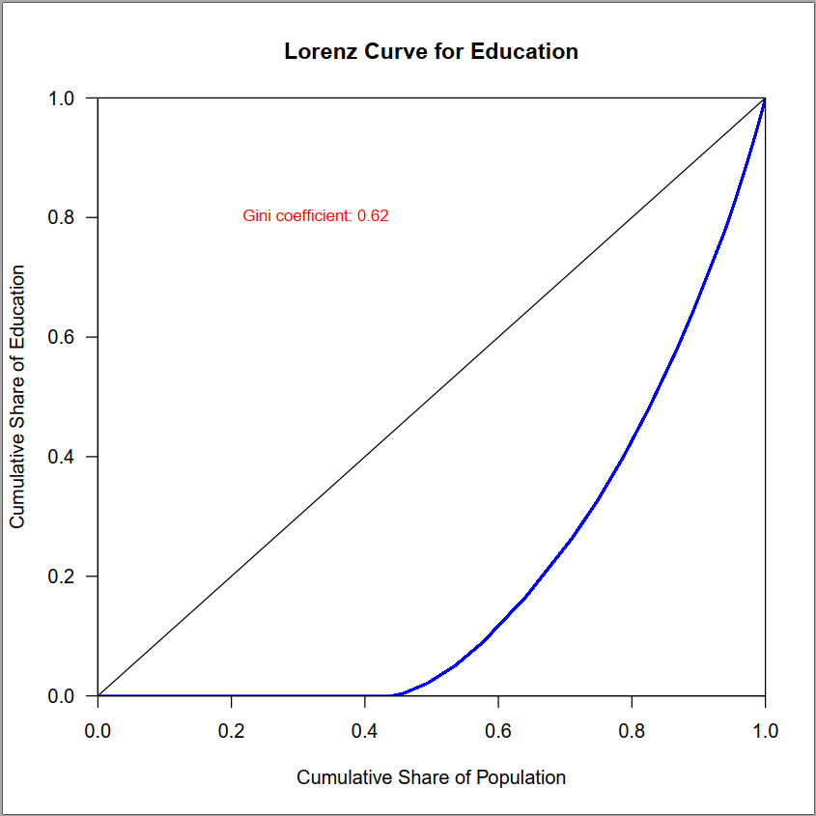
Inequality in Education : Lorenz curve for overall data

